Slide 1
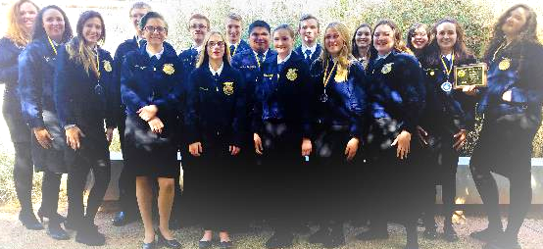
Warm-up
What are the three parts of an atom?
Today’s notes will be own your own paper for participation
CONGRATS CDE PARTICIPANTS!

Slide 2


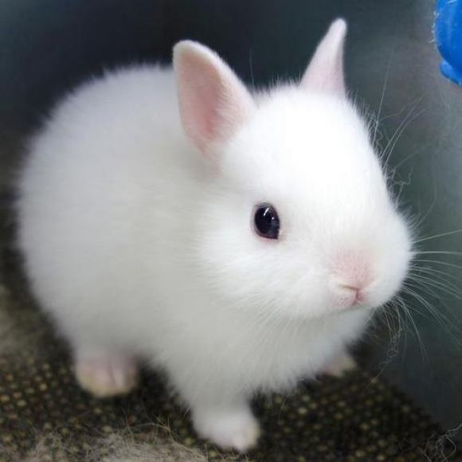
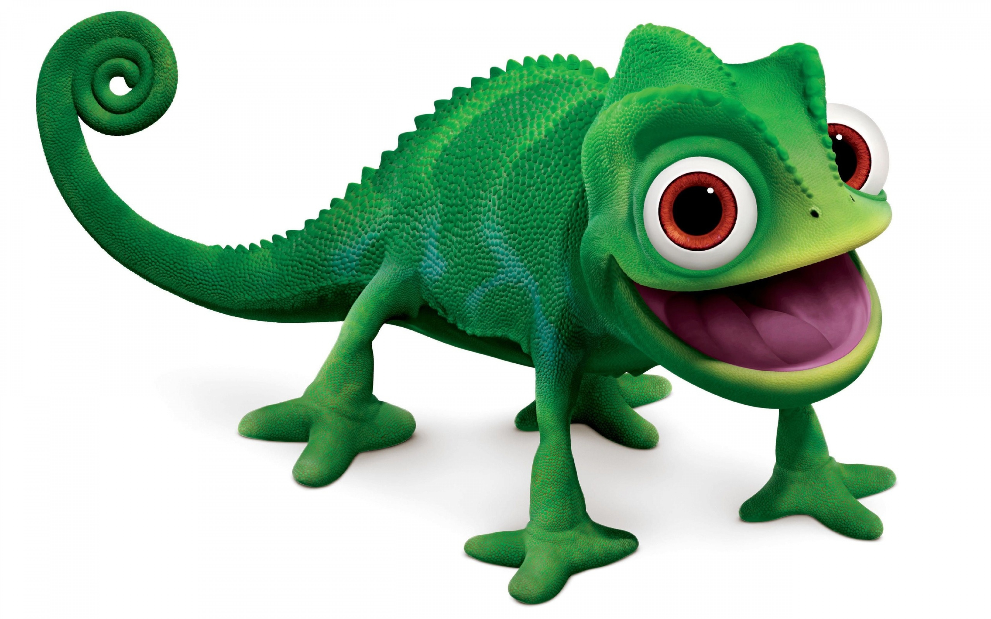
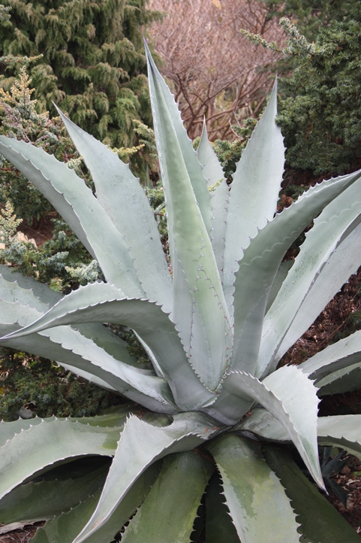


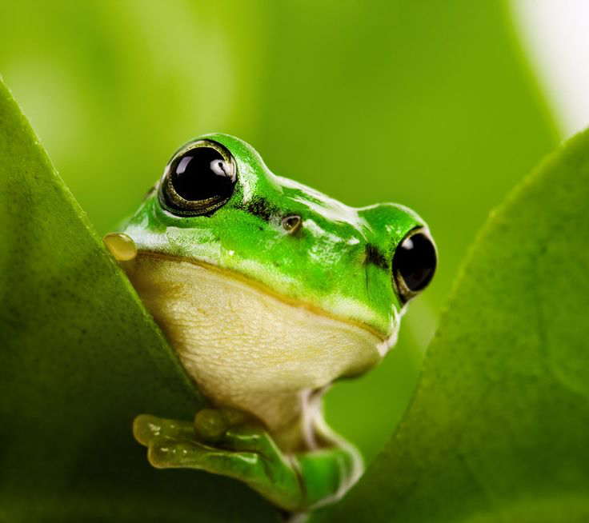
Organize the following items

Slide 3
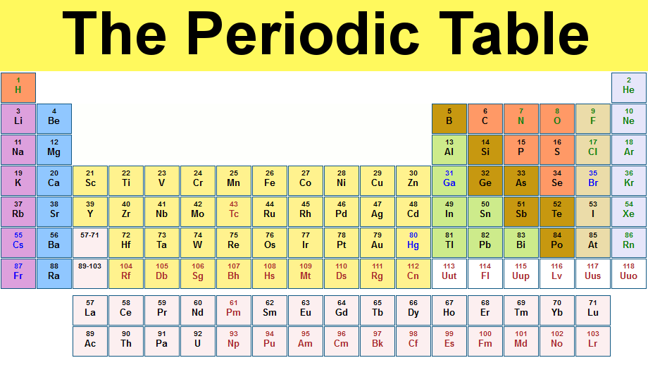
What is an element?
A substance that cannot be broken down
What makes an element unique?
    Its number of protons
What resource lists all of the elements?

Slide 4
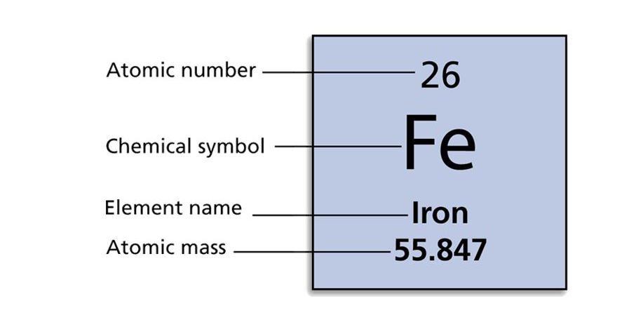
How to use a periodic table
Atomic Number—number of protons
Atomic mass—average number of protons and neutrons in the nucleus

Slide 5
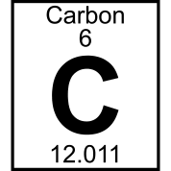
Practice
What element is this?
What is its atomic number?
What is its atomic mass?
How many protons?
How many neutrons?
How many electrons?

Slide 6
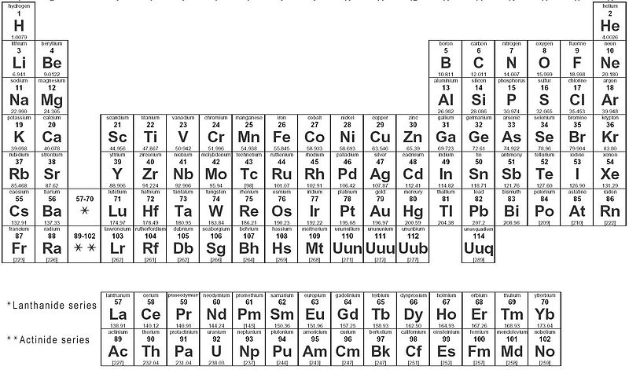
P table scavenger hunt!
Using the periodic table fill out the scavenger hunt table

Slide 7
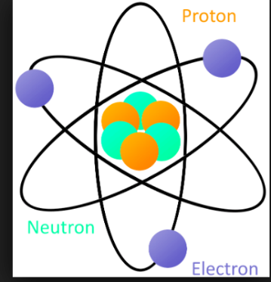
Class activity
form three groups to represent the atom parts
Notes:
Split class into three groups evenly
Start by using six students, have four in the center (2 protons/2 neutrons) and ask two students to run around them (ask what element, atomic mass, etc. He)
Then add 6 more students (4 protons/ 4neutrons / 4 electrons running around) again practice earlier lesson
Then add one extra electron, ask students what happens, (negatively charged, balance thrown off, define Ion)
Take away three electrons and ask students what happen (positively charged by 2, another Ion)
Balance out the atom and add 2 neutrons, ask what happens (nothing changes except atomic mass, define isotope)
For fun try to use “gangs from video” new boys, elected ones, pros
Return to seats for ppt

Slide 8
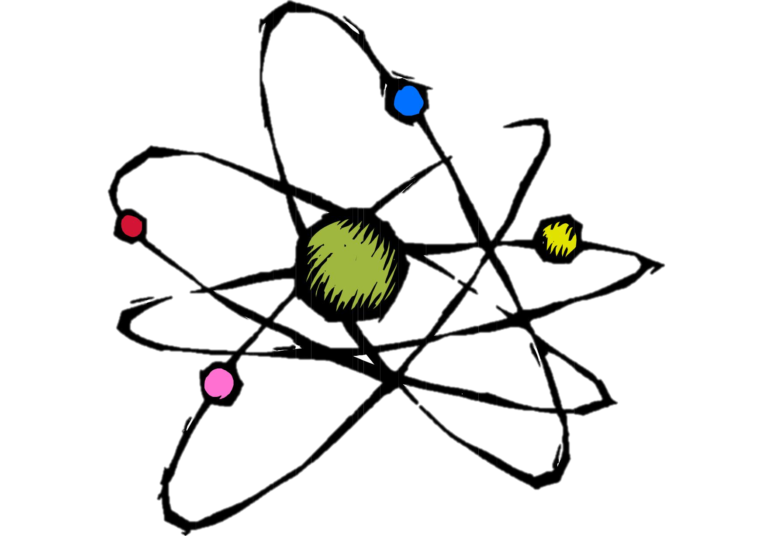
Recap
Isotope definition
  Each of two or more forms of the same element that contain equal numbers of protons but different numbers of neutrons in their nuclei
  What characteristic about the periodic table does this explain?
    Why its an average atomic mass
Ion definition
  an atom or molecule with a net electric charge due to the loss or gain of one or more electrons
    What happens if I add a proton?
      Changes element and creates ion

Slide 9
Note check!
As I go around to check notes, make sure that your notes are complete by having at least the answers to these 5 questions:
  What is an element?
  What is an atomic number and atomic mass?
  What is an isotope?
  What is an ion?
  Are there any questions you still have on the concepts covered today?

